Slide 1

Safe Sleep
November 2022

Slide 2

What is Safe Sleep?

Slide 3
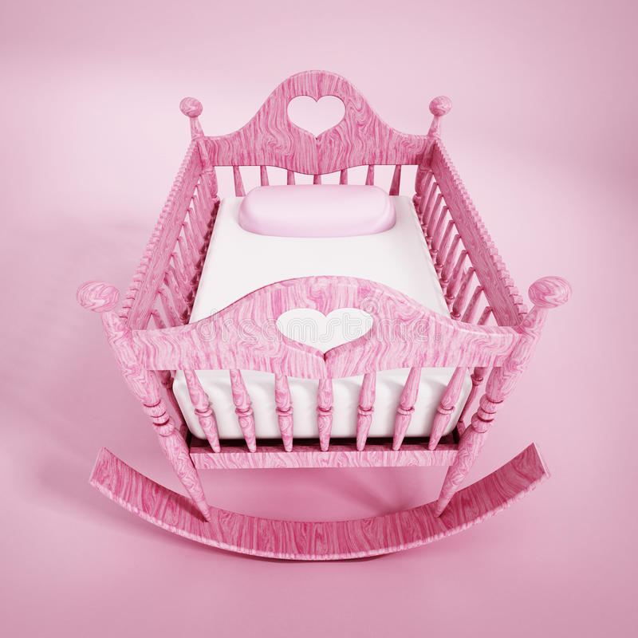
Q: How are our babies dying?
A: Sleep-Related Deaths

Slide 4
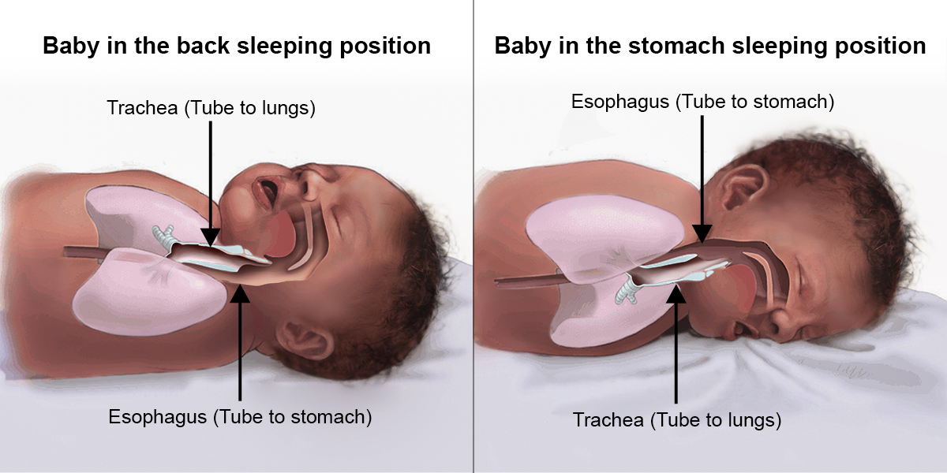
Will baby choke?

Slide 5
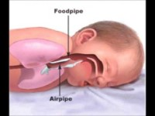

Slide 6

When can infants sleep on their stomachs?
Good head control
Roll over both ways
No longer swaddle
Roll on stomach while sleeping

Slide 7
What are the crib requirements for a licensed child care center?
(1)Unless the infant meets the requirements of paragraph (D) of this rule, each infant in attendance shall have a separate crib labeled with their name on it that meets the following requirements:
(a)Any crib manufactured before June 28, 2011 shall have a certificate of compliance (COC) on file. The center may have to contact the manufacturer of the crib to receive a COC if they do not request one from the retailer when they purchase the crib.
(b)Cribs with a documented manufacture date after June 28, 2011 have to meet the new federal standards to be sold, so they do not require a COC. The date of manufacture shall be attached to the crib.
(c)Cribs shall be used according to manufacturer's instructions.
(d)Each crib shall be of sturdy construction and have:
(i)Closely spaced bars with corner posts that do not exceed one sixteenth of an inch above the top of the end panel.
(ii)Spaces between the bars of the crib and between the bars and end panels of the crib shall not exceed two and three-eighths inches.
(e)Cribs shall be used with the mattress supports in their lowest positions and the sides in the highest position.
(f)Each crib shall have a firm mattress that is at least one and one half inches thick.
(g)The space between the mattress and the side or end panels of the crib shall not exceed one and one-half inches.
(h)Each mattress shall be securely covered with a waterproof material which can be thoroughly sanitized and is not dangerous to children. The waterproof cover shall be free of rips or tears.
(i)Each mattress shall have a properly fitted clean sheet that is changed at least weekly, when soiled, and before another child uses the mattress.
(2)Stacked cribs are prohibited.
(3)When cribs are in use they shall be spaced apart from each other by a minimum of two feet on all sides or the cribs shall be separated by a divider and have at least two feet of space on two of the sides or ends of the crib. If a divider is used between cribs, the divider shall meet all of the following requirements:
(a)Be constructed so that staff may view children through or around the divider.
(b)Be unbreakable in normal use situations.
(c)Be made of a nonporousnon-porous material that can be easily sanitized.
(d)Shall extendExtends up higher than an infant standing in a crib can reach up and shall not impede child care staff members' ability to hear the child.
(4)Bumper pads shall not be used.
(5)Nothing shall be placed or hung over the side that obstructs the provider's view of the infant.
(6)Infants shall not be placed in cribs with bibs or any other items which could pose a strangulation or suffocation risk.
(7)No blankets shall be in the crib for infants under twelve months old. A one-piece sleeper or wearable blanket is permitted. Only children who are not yet able to roll-over are permitted to be swaddled using a wearable swaddling blanket.
(8)The cribs may be placed in storage on the premises if not currently assigned to an infant.
(9)Infants shall be placed in their cribs for sleeping, and shall not be allowed to sleep in bassinets, swings, car seats or other equipment. If a medical condition exists where a child needs to sleep in equipment other than a crib, written permission shall be obtained from a physician and shall be on file.
(10) Infants under twelve months old shall be placed on their backs to sleep unless the parent provides written authorization on the JFS 01235 "Sleep Position Waiver Statement for Child Care" (rev. 12/2016) signed by the child's physician. The JFS 01235 shall be maintained on file for review and is valid for one year. Infants who are able to roll from back to front and front to back shall be placed initially on their back for sleeping but allowed to remain in a position they prefer.
(11) Cribs assigned to a child shall not be used for storage of toys and other materials

Slide 8
Nothing but Baby in the Crib
No toys
No stuffed animals
No pillows
No blankets
No bibs
Disconnect pacifier from pacifier holder
No bumper pads

Slide 9
Clothing
Add a layer of clothing, dress the infant in a wearable blanket, or adjust the temperature in the room if it is too cold.
Do not over bundle infants with too many clothes. Studies have shown that overheating can lead to SIDS.

Slide 10
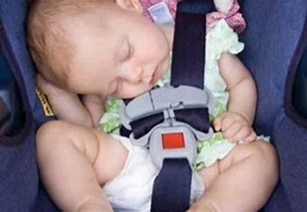
Car Seats, Strollers, Swings, and Bouncers
Infants can and have suffocated in car seats, swings, and bouncers.
Positional Asphyxia

Slide 11
Tummy Time
Tummy time should be offered daily
Strengthens neck and shoulder muscles
Promotes social emotional, sensory, and motor development
Reduces skull deformity
Start with 1-2 minutes for younger infants
Gradually add time, minimum of 10-15 minutes for older infants

Slide 12


Slide 13

SHARE THE KNOWLEDGE!
Staff
Parents
Family
Friends

Slide 14
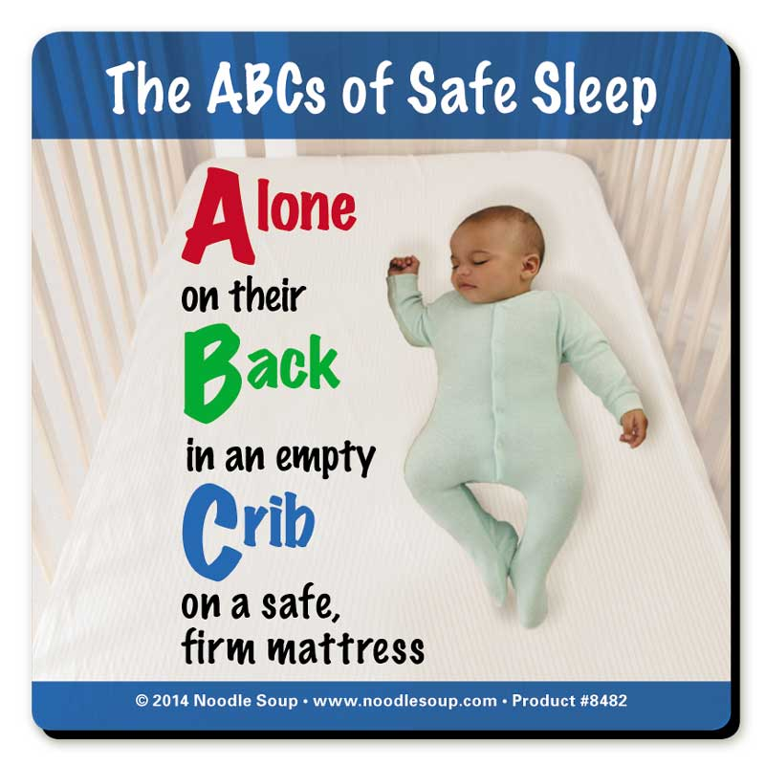
Questions and Reflection

