Slide 1

CACFP Annual Training
Notes:
Good morning and thank you for attending Part 1 of CACFP Annual Training. I’m Chris, your Child and Adult Care Food Program administrator, here to guide you through this brief training. When you’ve finished Part One and Part Two, please sign the training sign-in sheet to receive credit.

Slide 2
What We’ll Cover
Meal Patterns for Infants
Meal Patterns for Children
Serving Sizes
Paper Point of Service Documentation
Notes:
Today, we’ll cover the Meal Pattern for infants under 12 months meal patterns for children 1-12 and the appropriate portion sizes and documenting at the Point of Service

Slide 3
Meal Pattern for Infants
6 weeks through 5 months
AM: 4-6 oz of Iron Fortified Infant Formula
Lunch: 4-6 oz of Iron Fortified Infant Formula
Supper: 4-6 oz of Iron Fortified Infant Formula
Notes:
Current CACFP Guidelines have different standards for infants from 6 weeks to 5 months old and infants 6 months old to 1 year. AT this stage of development, infants’ needs are relatively simple. At AM Snack, Lunch, and Supper, all we must serve is 4-6oz of Iron Fortified Infant Formula, or IFIF.

Slide 4


6 months through 11 months
AM Snack: 2-4oz. of formula & as developmentally appropriate 0-2 tablespoons of a fruit or vegetable & as developmentally appropriate 0-4 tbsp. of infant cereal or up to ½ a slice of bread.
Lunch & Supper: 6-8oz of formula & as developmentally appropriate 0-2 tbsp. of a fruit or vegetable & as developmentally appropriate 0-4 tbsp of Infant cereal or meat, fish, or poultry.
Notes:
When an infant turns 6 months, we begin to offer soft, solid foods in addition to IFIF. READ THE SLIDE

Slide 5
Meal Pattern for Children
Snack | 1-2 years | 3-5 years | 6-12 years
Milk | 4oz | 6oz | 8oz
M/MA | ½oz | 1.5oz | 2oz
Veg | 4oz | 2oz | 4oz
Fruit | 4oz | 2oz | 4oz
Grain | ½oz eq | ½oz eq | 1oz eq
Lunch & Supper
Milk | 4oz | 6oz | 8oz
M/MA | 1oz | 1.5oz | 2oz
Veg | 2oz | 2oz | 4oz
Fruit | 2oz | 2oz | 2oz
Grain | ½ oz eq | ½oz eq | 1oz eq
AM Snack: Only serve two of the five components.
Ex. Milk and graham crackers, oatmeal and bananas, Rice Krispie cereal & milk.
Lunch & Supper: Serve all 5 components
Ex. Chicken Nuggets, Grean Beans, Peaches, and Milk (the breading on the nuggets counts toward the grain component).

Slide 6
Point of Service Documentation
Point of Service: documenting evidence of meal service or completed CACFP Labor at the time it is happening.
Time CACFP Labor begins-record at point of service
Total number of meals served- record at the point of service
What foods were served to infants and how much was given- record at point of service
Time CACFP Labor Ends- record at point of service
Notes:
Because accurate recordkeeping is imperative in administering CACFP, we document at the point of service. By “point of service” we mean “at the time it is happening”. We document the following four things at the point of service. 1. The time CACFP Labor begins. CACFP Labor includes anything you do to conduct or prepare for a safe and healthy meal service, including washing hands before cleaning and sanitizing tables/trays before and after meal service, putting on hairnets, washing hands before putting on gloves and after taking them off preparing or serving bottles, portioning meals, supervising children’s handwashing, and the completion of CACFP paperwork. CACFP Labor may also include cleaning up spills or taking out trash after a meal service. 2. The total number of meals or snacks served that meet the meal pattern and minimum serving sizes. 3. What foods and formula are served to infants, and how much of each. And 4.) the time CACFP Labor ends.

Slide 7
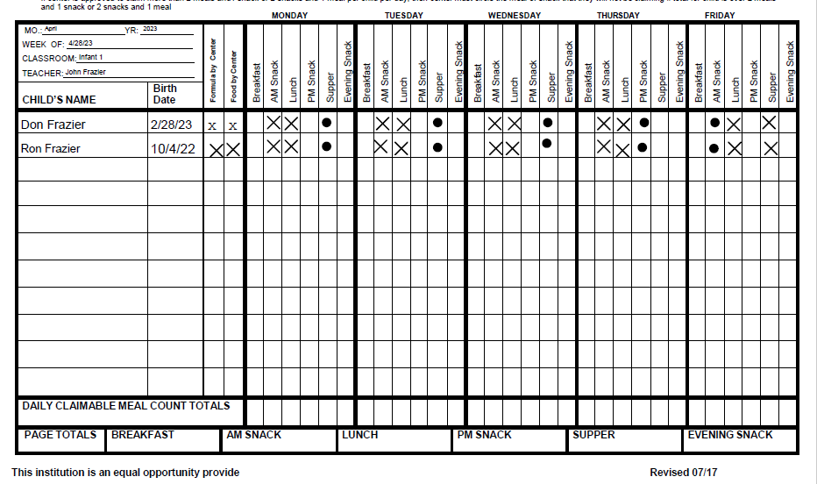
Infant Meal Count Sheets
Notes:
This is called the Infant meal count sheet or IMC. At the beginning of the week, please write-in everything indicated by the red arrows, including the week, month, and year in the top left corner and all the infants present and their DOB. In most cases, you will also indicate that we provide formula and food (as developmentally appropriate) next to each child. Some exclusions are if parents provide their own formula or if their mom breastfeeds.
On X’s indicate that Ron or Don was present and ate, and O’s indicate that they were not present and did not eat.

Slide 8
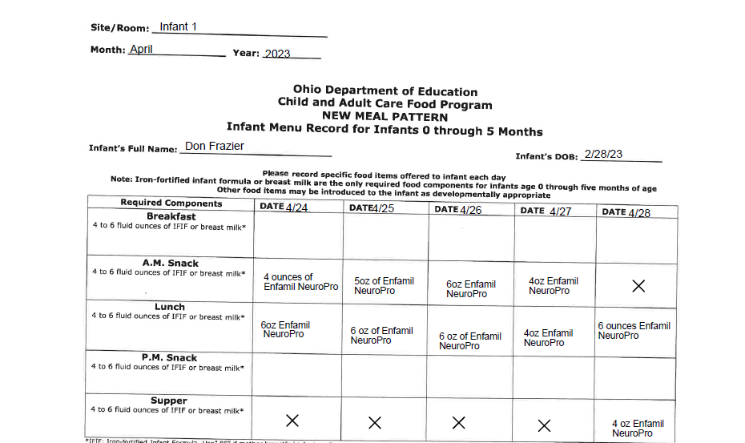
Infant Meal Records
Notes:
This form is the Infant Meal Record, or IMR, for Infants 6w-5mo. Notice anything? It matches with, and expands upon, the information in the IMC!
On this form, please indicate what brand of formula was given and how much at each meal. Don’t forget to write the date!

Slide 9
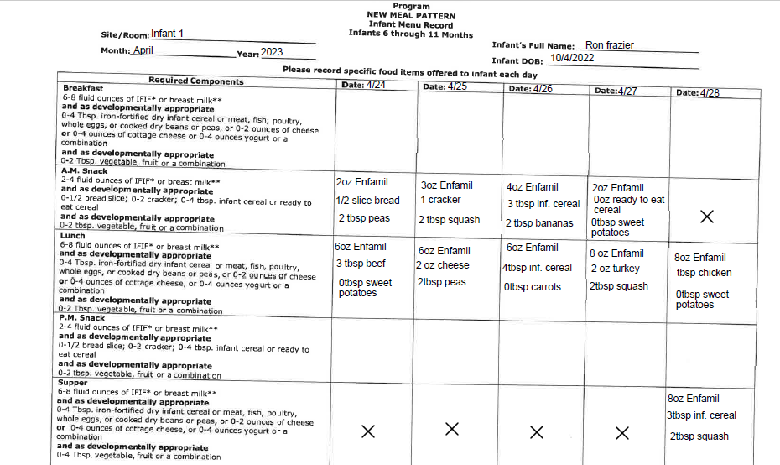
Notes:
This is the IMR for infants 6mo-1y. Like the 5-month IMR, it matches and expands upon the IMC, but accounts for the different meal pattern. In fact, you can even read the meal pattern on the left-hand side! You may notice that each item has different serving sizes. This is because we note what Ron, here, ate, and not what we expected him to eat. Here we can get a sense of what foods he’s open to trying and see what he’s becoming accustomed to. The IMR is also a helpful tool to track any possible food sensitivities in early development, so please be accurate & specific in your recordkeeping!

Slide 10
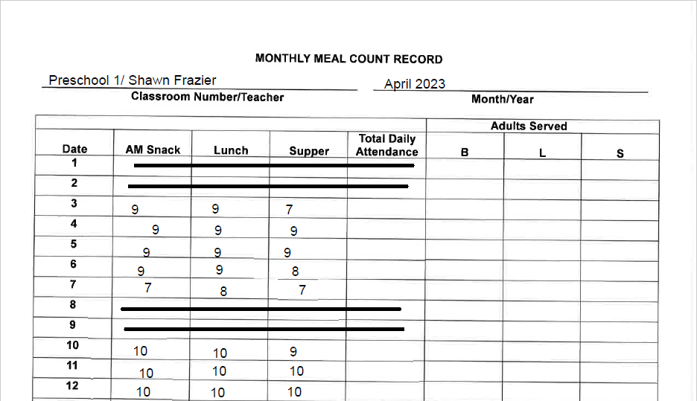
Monthly Meal Count Sheets
Notes:
The Monthly Meal Count Record is as straightforward as it gets. For any children over the age of 1, we use this sheet to count meals served. At the beginning of the month, please write in the age group/classroom name and the primary teacher for that room as well as the month and year.
It’s also a good idea to cross out any weekend days, PD days, and holidays at the start of the month

Slide 11
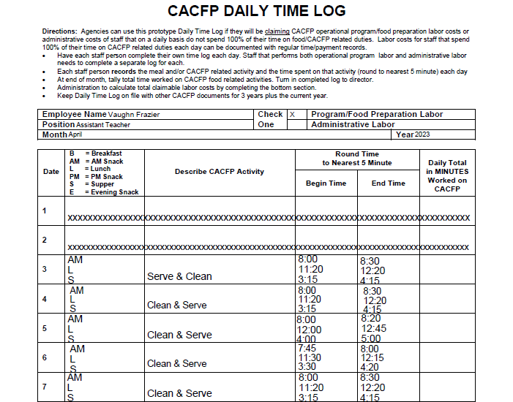
AM Snack: up to 30 minutes from 7am-10am
Lunch: up to one hour from 11am-1pm
Supper: up to one hour from 3pm-5pm
Notes:
Finally, this is CACFP Labor Log.
Every teacher should receive one of these at the beginning of each month. Like the Monthly Meal Count Sheet, it is a good idea to cross out holidays, weekends, and PD Days.
For each meal you assist in serving, note AM Snack, Lunch, or Supper in the left-hand column.
In the second column, briefly describe your CACFP work for that meal service. Because it can be many procedural tasks, all we ask that you write is “clean and serve”.
In the third and fourth columns, please write in the time you began preparing for and ended each meal service. Please round to the nearest five minutes.
Any Labor log showing signs of time copying, such as quotation marks or arrows, or indicates labor on weekend, holiday, or PD days, is invalid.
A Labor log is also invalid if it is not signed by the employee at the bottom of the second page or if they claim the meal windows.
The meal windows, and the maximum claim for each are as follows: *read the box*.

Slide 12
Thank you!
Additional resources:
Expanded portion table for AM Snack
Expanded portion table for Lunch and Supper
Grain Component Exhibit A

